Slide 1


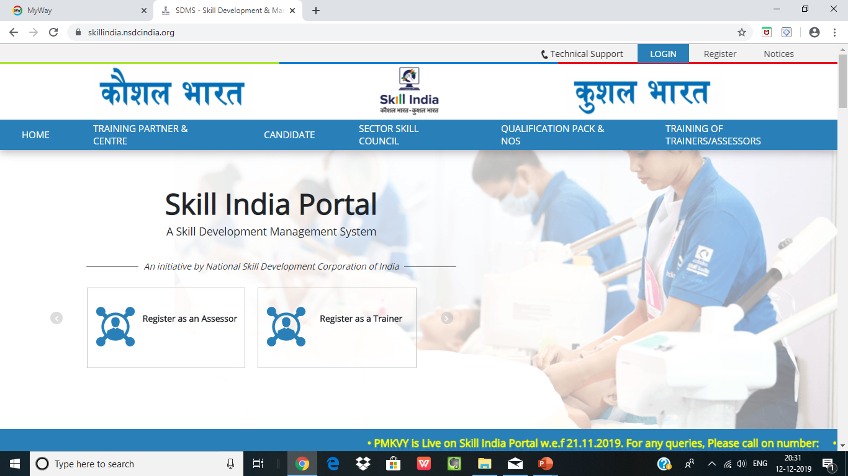
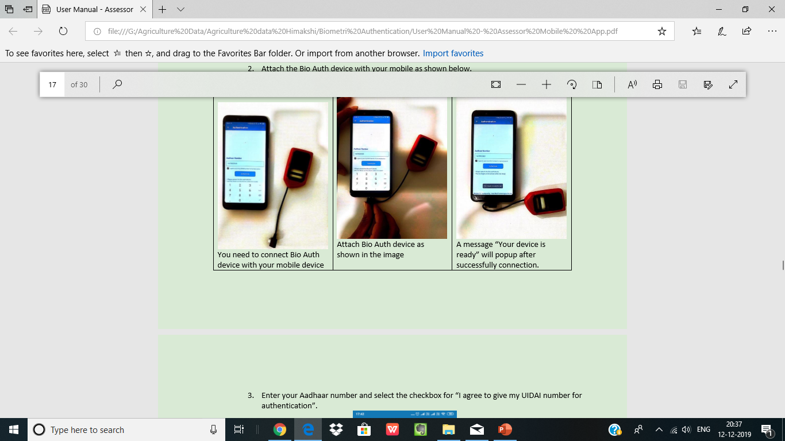
bio-authentication process
PRESENTED BY
DR.HIMAKSHI BHATI KUSHWAHA

Slide 2
Key features of the Assessor Application
• Captures geo-location of the assessor.
• Authenticate the Assessor through Aadhaar at the start and end of assessment
• Capture the attendance of candidates during the assessment through Bio-authentication with UIDAI.
• Captures the time in and time out of the Assessor.
• Captures photograph throughout the assessment

Slide 3

Operational Pre-requisites for using the App
The Application is applicable only for conducting assessment for batches pertaining to the scheme PMKVY
The assessor must be TOA certified and registered through Aadhar.
The assessor must log in the APP using their respective SIP (Skill India Portal) credentials.
The Assessor must ensure the Aadhar card/no. is available with them at the time of Aadhar Authentication.

Slide 4
Technical specifications for using the Aadhaar enabled Assessor Application
Required RD Service Device Specification
Fingerprint Scanner Device for use with Mobile, Tablet, POS Device etc.
STQC Certified
API/SDK - Android 6.0 and Above
Integrated USB 2.0 and above Connector
Micro USB & Standard USB
UIDAI Certified Registered Device Card Capacity of 100000 fingerprints
Communication Interface - USB / Micro Port for bio-authentication device

Slide 5
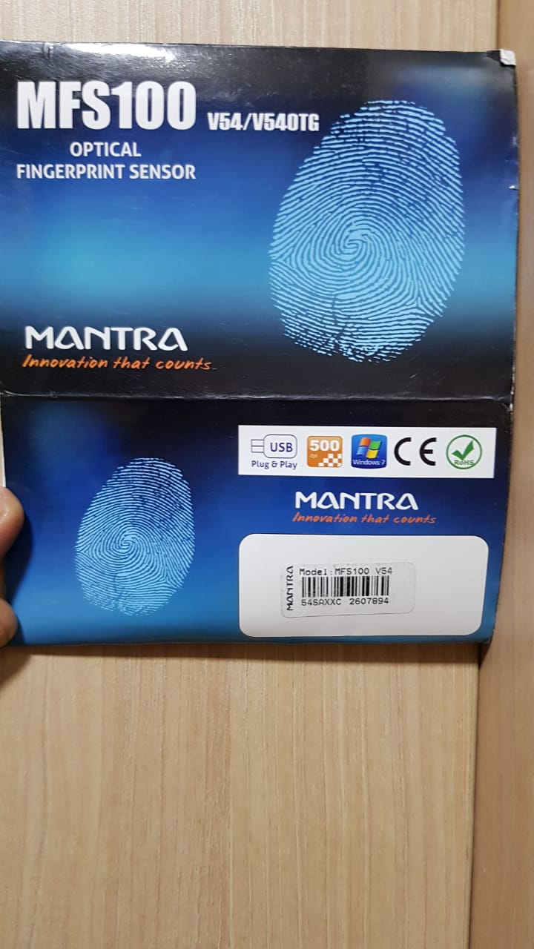
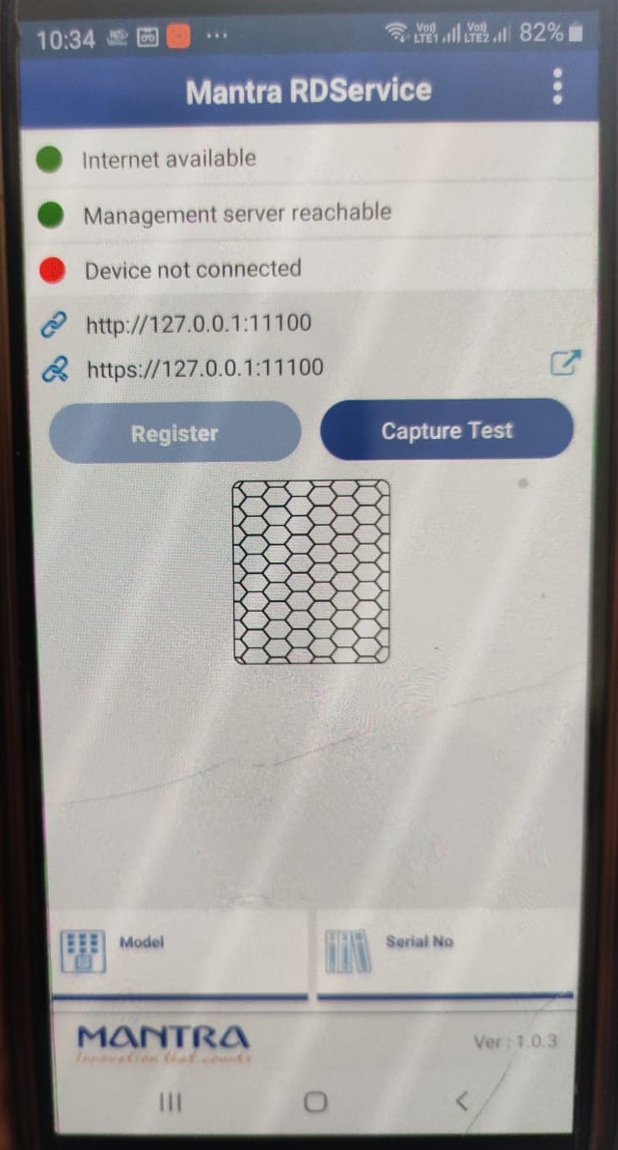
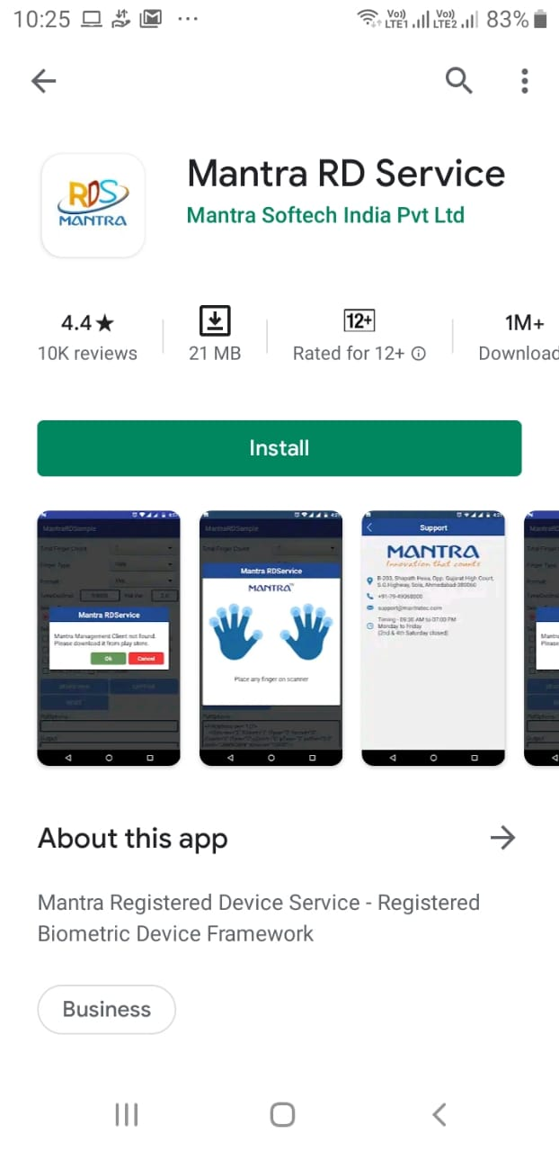
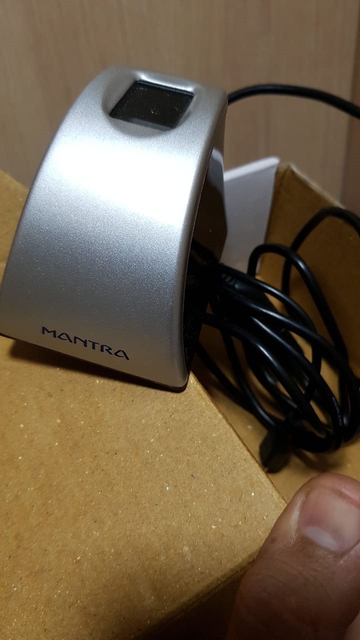
Bio Auth Device
Device Name
Once installed Open APP
Install Mantra RD Services from Google Play store
Dot appears green when internet on mobile phone is on
Dot appears RED : If bio auth device not connected with Mobile Phone
Dot appears GREEN: If bio auth device is connected with Mobile Phone
NOTE: Please insure that the OTG cable is enabled on your mobile phone. Please go to the mobile settings for the same.

Slide 6
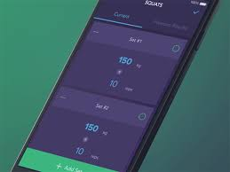
Technical specifications for using the Aadhaar enabled Assessor Application
Required Mobile Device Specification
Android Version 6.0 (Marshmallow) and above.
RAM greater than 2GB.
Internal Memory capacity 4GB and above.
Camera- 2MP and above.
GPS Enabled.
Minimum Network requirement- 3G and above.
Enable USB OTG Support on your mobile handset.

Slide 7
GUIDELINES TO BE FOLLOWED ON THE DAY OF ASSESSMENT
Complete your Aadhar authentication process 1 day prior to assessment
The mobile phone on which you will login to Assessor App must be fully charged
The mobile camera must be properly working and of good quality
Your mobile GPS should be on from the time your are leaving to conduct the assessment and be sure that it will remain on till the end of the assessment (Final geo tag at the end)
In case of any difficulty in regards to Assessor app immediately connect on the following:
Mobile Number:9315132748 (Helpline number)
Email ID: assessorsupport@nsdcindia.org

Slide 8

Download and install application on Android mobile/TAB(ACPL/Morpho/Mantra & Assessor app)
Download the PMKVY- Aadhaar enabled Assessor application from Google Play-Store or access the app from the below mentioned link:
https://play.google.com/store/apps/details?id=com.nsdc.assessor

Slide 9
Types of Users
First Time User:
Are those who downloads the application for the first time in their mobile handset devices and logs in with their SIP credentials.
NOTE: It is recommended that the Ist Time authentication should be completed one day prior the assessment, so that the errors which occurs due to low net connectivity at the Training center while processing the authentication can be avoided.
Existing/Second Time User:
Those who have already logged in the assessor application once through their specific mobile handset and have created their M-Pin.

Slide 10
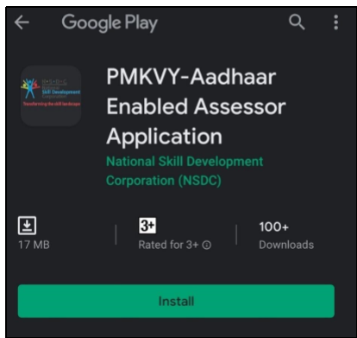
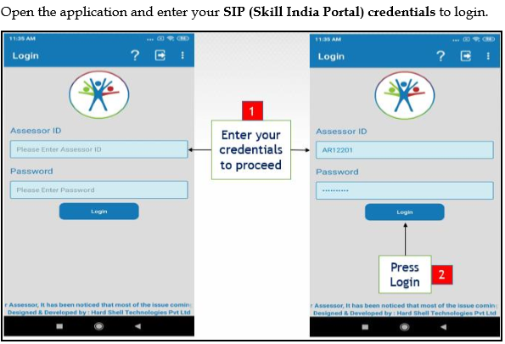
First Time User
1. Download App from Google Play Store
2. Log in using your SIP (Skill India Portal) Credentials
Contd.

Slide 11
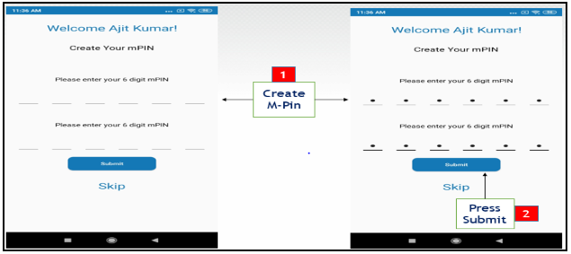
First Time User
3. Create your 6 digits M-PIN After getting logged in using SIP credentials
Contd.

Slide 12
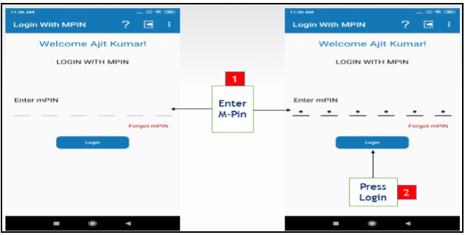
First Time User
4. After the assessor log in with their M-Pin, the app will re-direct the user to the Aadhaar authentication process.
Contd.

Slide 13
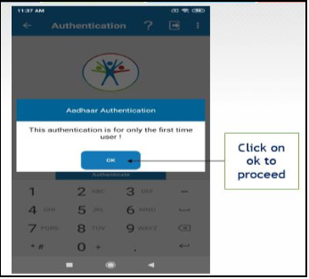
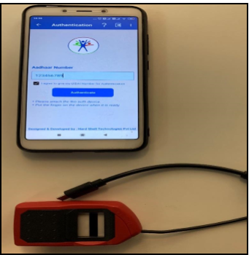
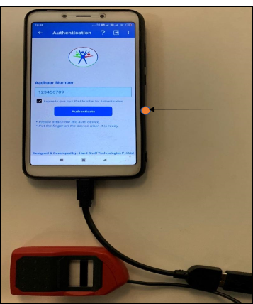

First Time User
5. After entering M-Pin, the 1st time Aadhar authentication message will pop up.
6. Enter Aadhar Number and click “I agree to give my UIDAI number for authentication
7.Connect the Bio-authentication device to the mobile handset.
Contd.

Slide 14
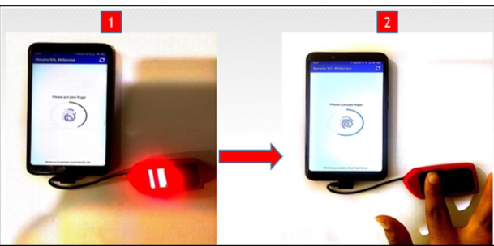
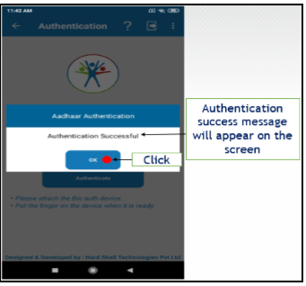
First Time User
8. Message will appear to put your finger on the Bio-Auth Device
9. Once the finger print got scanned successfully the message will pop up for Authentication Successful
Contd.

Slide 15
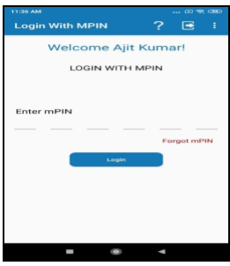
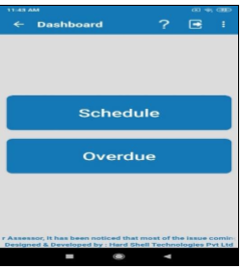
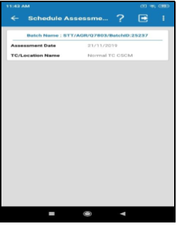
Existing/Second Time User
1.Enter M PIN and Login
2.Assessor Dashboard after Login
3.Details of batches once you tap on schedule
Assessor can view the upcoming batches
Batches which are accepted on the Skill India Portal will be visible
Assessor can view the batches for which assessment date has elapsed
Contd.

Slide 16
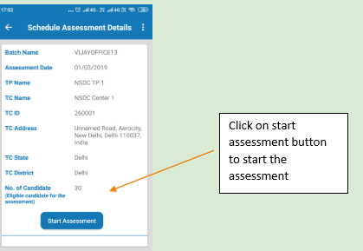
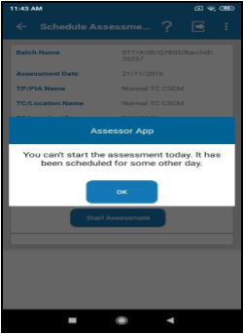
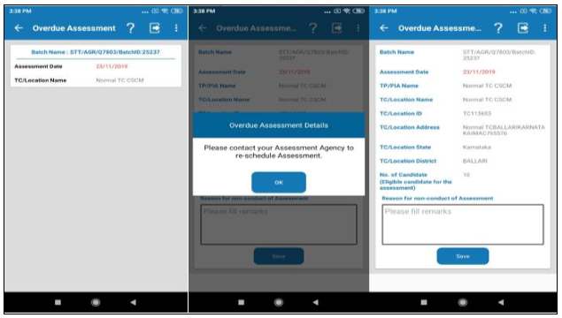
Existing/Second Time User
4. If batch scheduled for same day then Click Start Assessment
5. If batch scheduled for some other day
6. If batch Is reflecting in overdue
Click Start Assessment

Slide 17
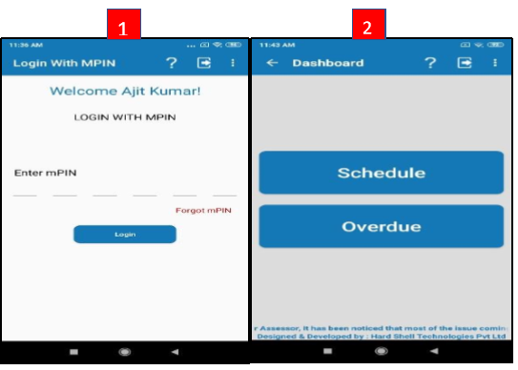
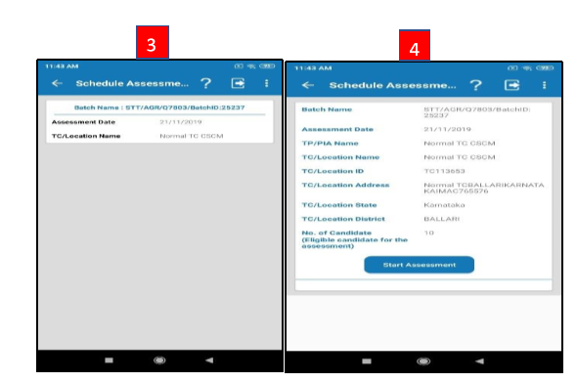
Steps to Conduct theAssessment of a batch
Contd.

Slide 18
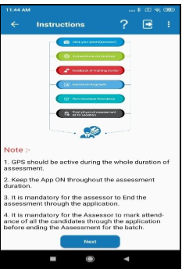
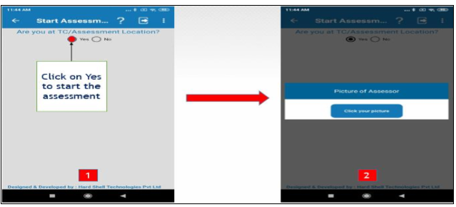
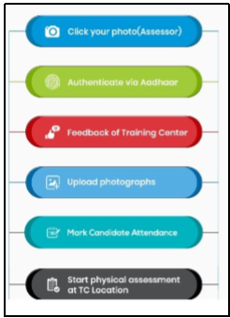
Steps to Conduct theAssessment of a batch
5.Read Instructions
6.Once clicked Next in step 5 This page will appear
Contd.

Slide 19
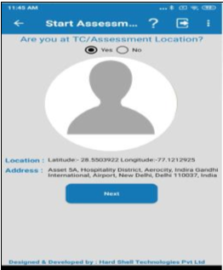
Steps to Conduct theAssessment of a batch
7.After Clicking the Picture this screen will appear with your complete Geo tag. This will get online submitted to NSDC
8. Click Next in step 7, you will get redirected to Aadhar Authentication
Contd.

Slide 20
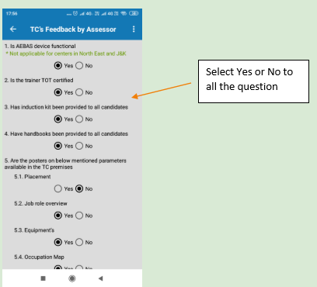
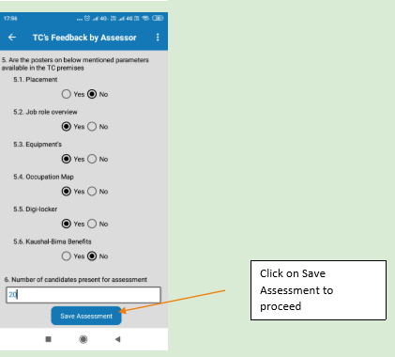
Steps to Conduct theAssessment of a batch
9. After Successful bio-authentication again, the TC Feed back form will appear on the screen
Contd.

Slide 21
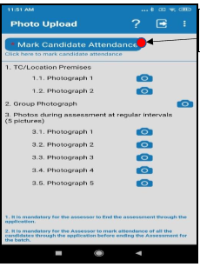
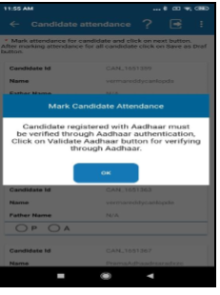
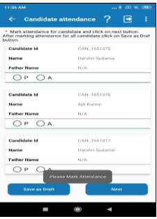
Steps to Conduct theAssessment of a batch
10.Mark Attendance
Click Mark Attendance
Manual Attendance
Only for those candidates where Bio auth attendance is not submitted
Contd.

Slide 22
Steps to Conduct theAssessment of a batch
10 a. Marking Attendance through Bio auth
Once clicked OK The candidate name will appear with the tab “ Validate Aadhar’
Candidate attendance through Bio-Authentication device is similar to previous Assessor Bio-Authentication ,
Enter Aadhar Number
Connect Bio-authentication device to the mobile handset
Click the Authenticate button.
Contd.

Slide 23
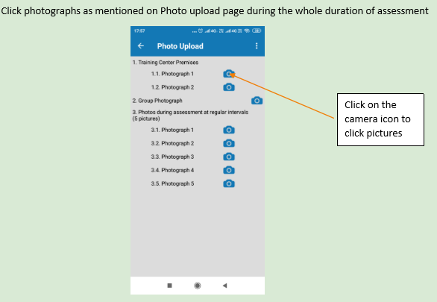
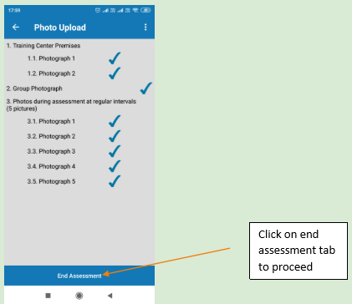
Steps to Conduct theAssessment of a batch
NOTE: PLEASE DON’T SUBMITT THE BLURRED PHOTOGRAPHS

Slide 24
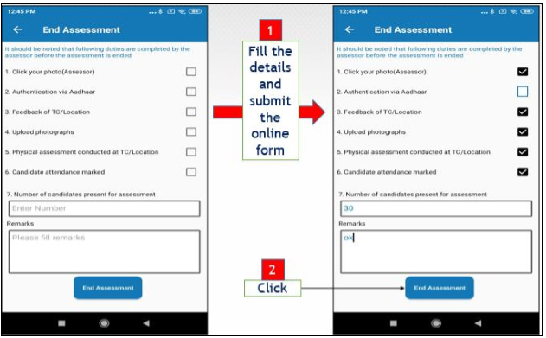
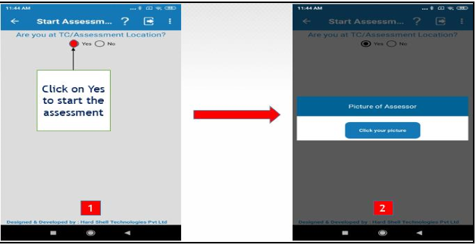
END ASSESMENT
1. Complete the details and click End Assessment
2. After End Assessment it will re-direct you on start assessment page for final geo tag
NOTE: Before submitting the Final assessment it is instructed to please check the attendance with the hard copy (attendance sheet), to be sure the attendance is correctly marked. Once the attendance gets submitted it cannot be changed
Contd.

Slide 25
END ASSESMENT
Contd.

Slide 26
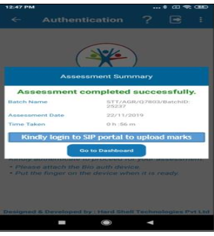
END ASSESMENT

Slide 27


