Slide 1

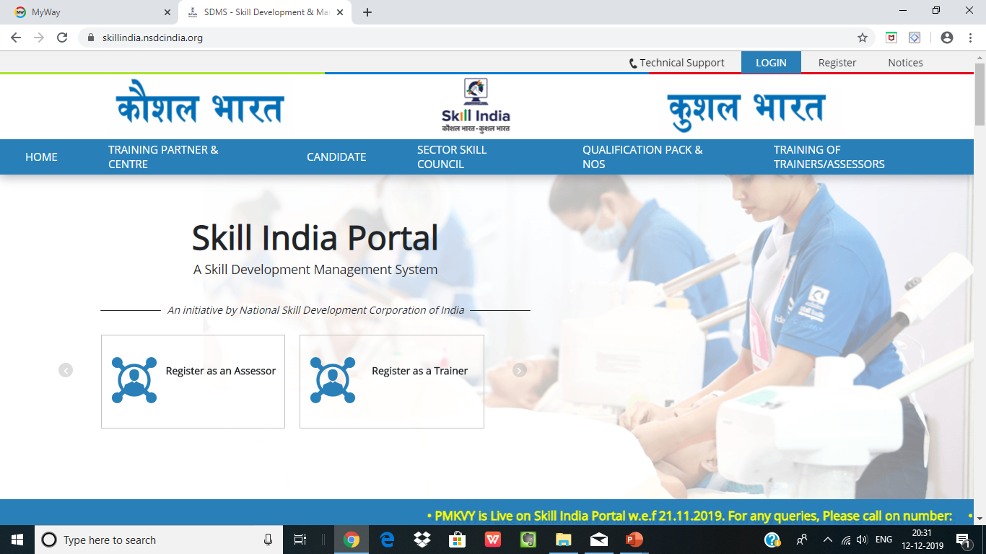
Skill india Portal
PRESENTED BY
DR.HIMAKSHI BHATI KUSHWAHA

Slide 2

CONTENT.
Registration .
First Time Login
Assessor Registration Form
Search & Training Requests
Add Training Requests
Remove Training Requests
View Batches
Apply to the Batch

Slide 3
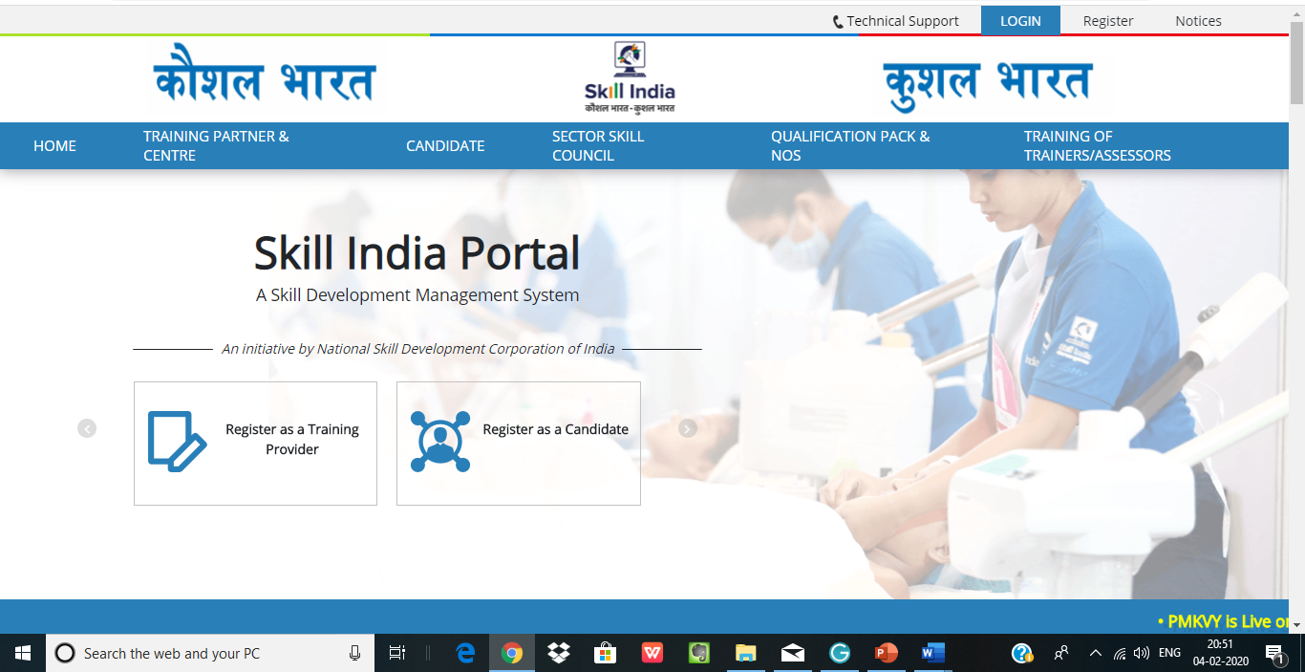
Registration Process- An Assessor

Slide 4
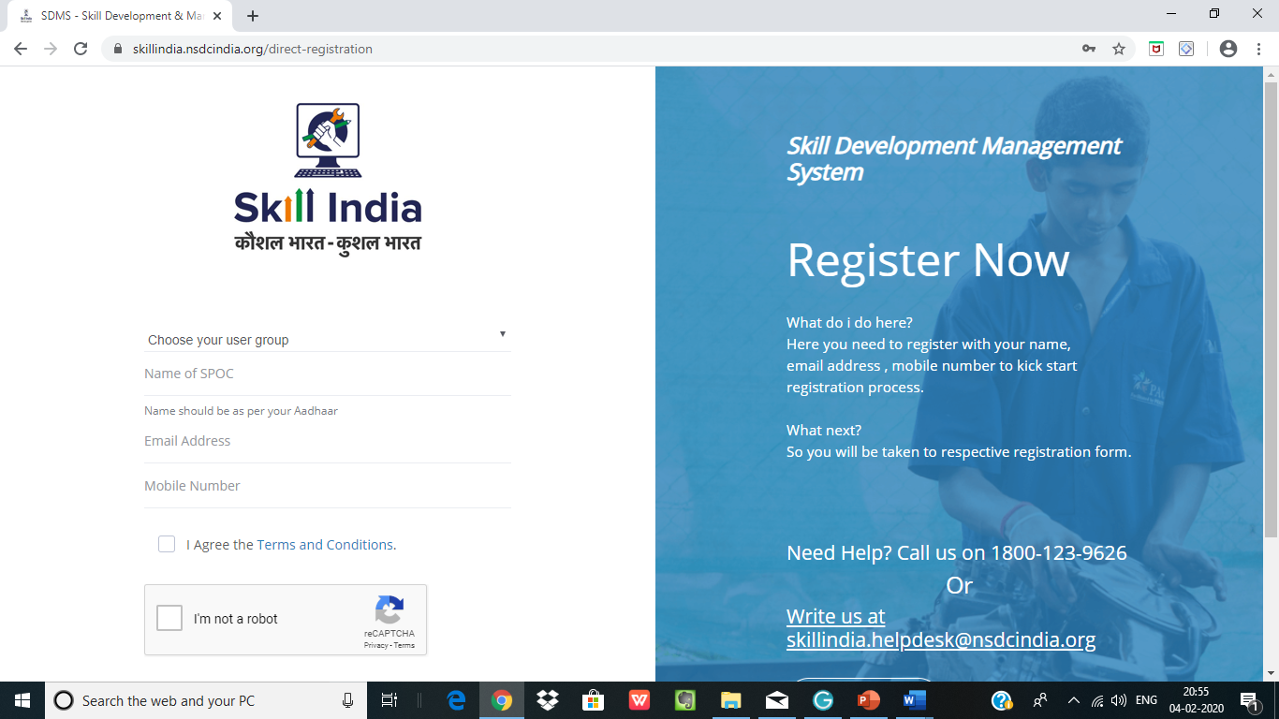
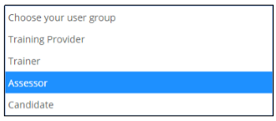
Registration Process- An Assessor

Slide 5
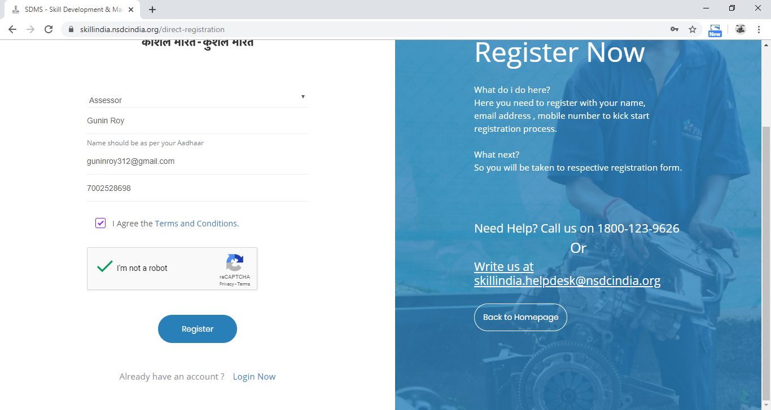
Registration Process- An Assessor

Slide 6
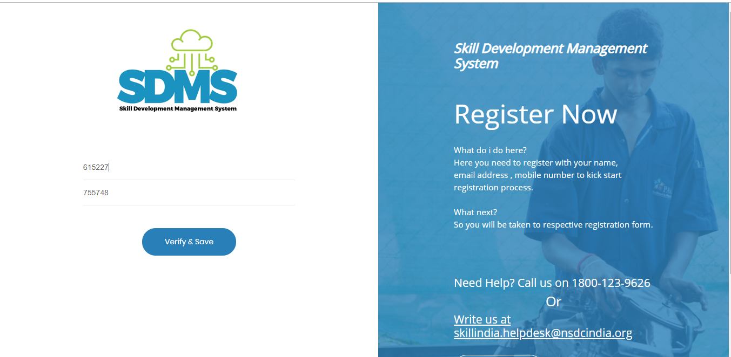
Registration Process- An Assessor

Slide 7

Registration Process- An Assessor

Slide 8

First Time Login-An Assessor

Slide 9

First Time Login-An Assessor

Slide 10

First Time Login-An Assessor

Slide 11
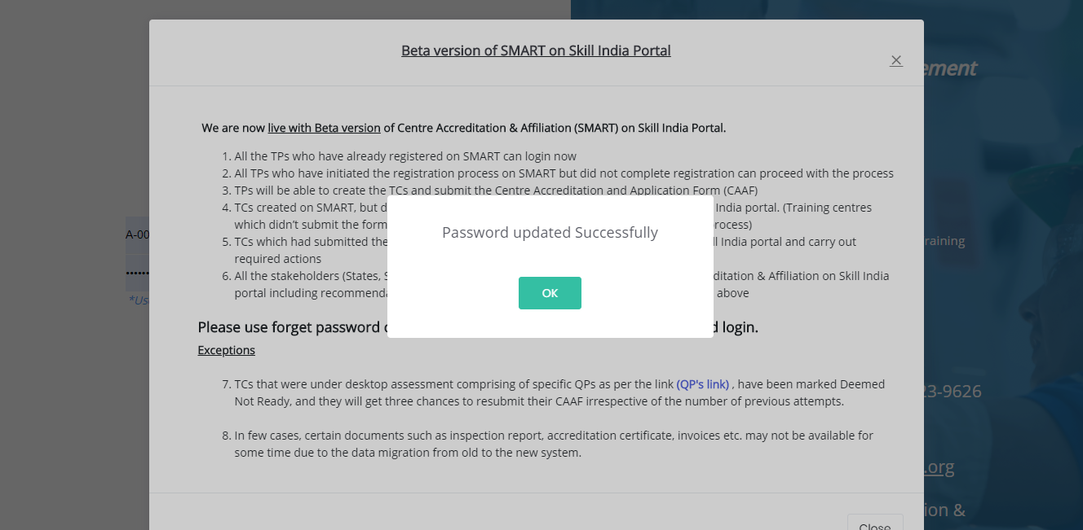
First Time Login-An Assessor

Slide 12
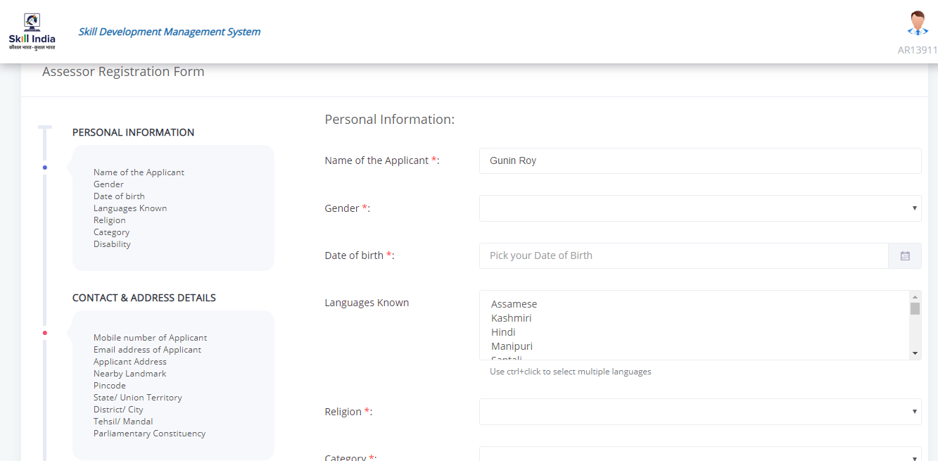
First Time Login-An Assessor (Page 1)

Slide 13
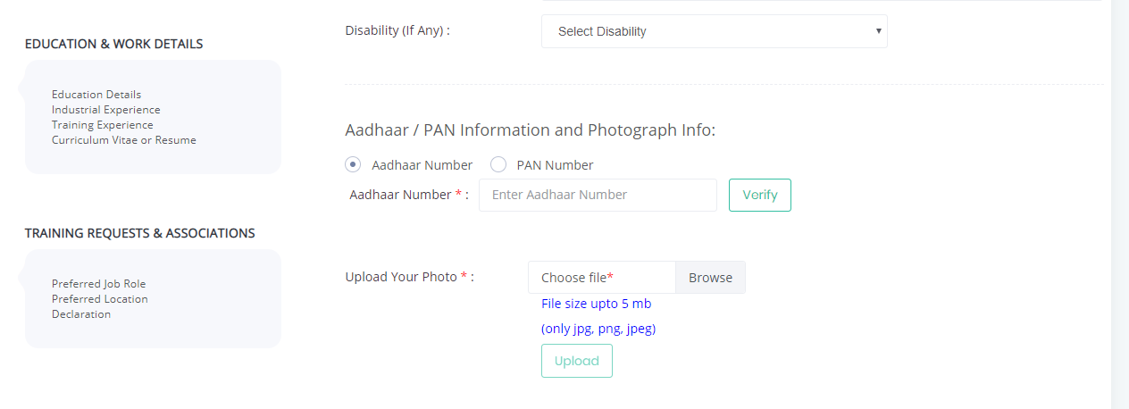
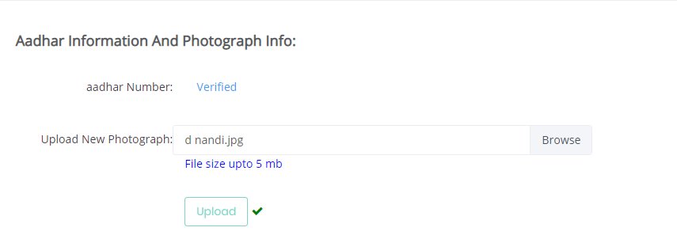
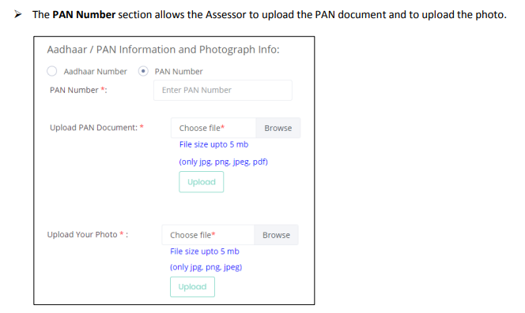
First Time Login-An Assessor (Page 1)

Slide 14
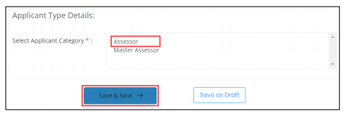
First Time Login-An Assessor (Page 1)

Slide 15
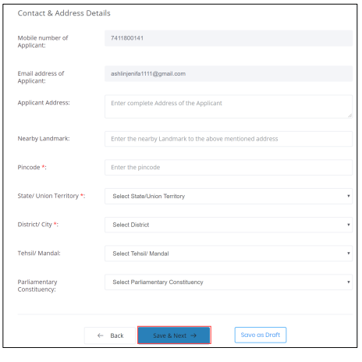
First Time Login-An Assessor (Page 2)

Slide 16
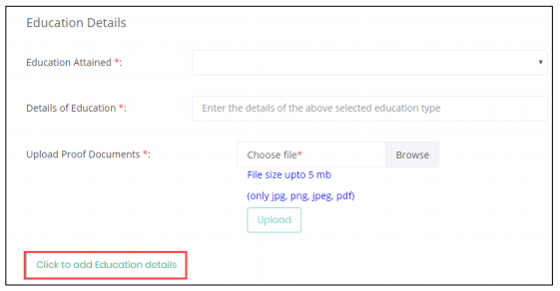
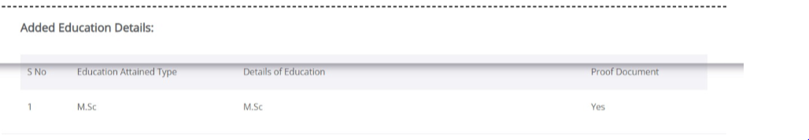
First Time Login-An Assessor (Page 3)

Slide 17
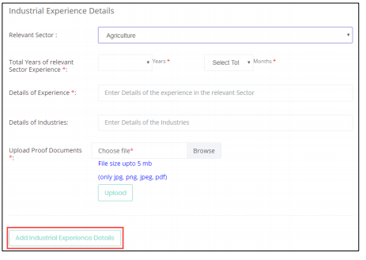
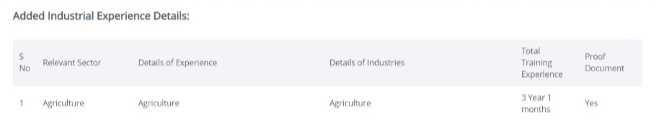
First Time Login-An Assessor (Page 3)

Slide 18
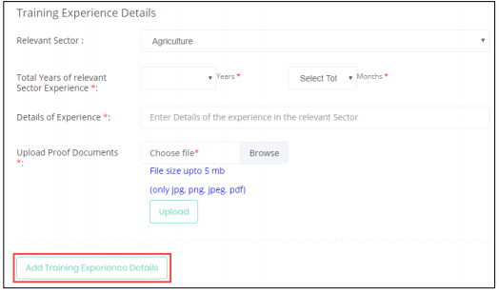
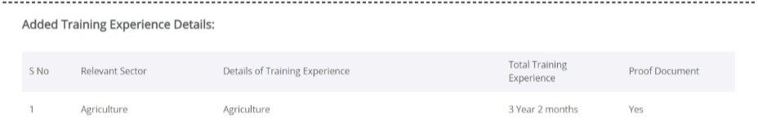
First Time Login-An Assessor (Page 3)

Slide 19
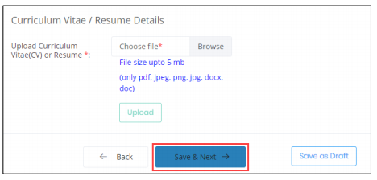
First Time Login-An Assessor (Page 3)

Slide 20
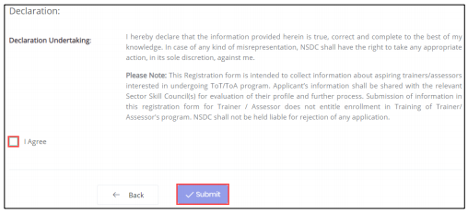
First Time Login-An Assessor (Page 4)

Slide 21
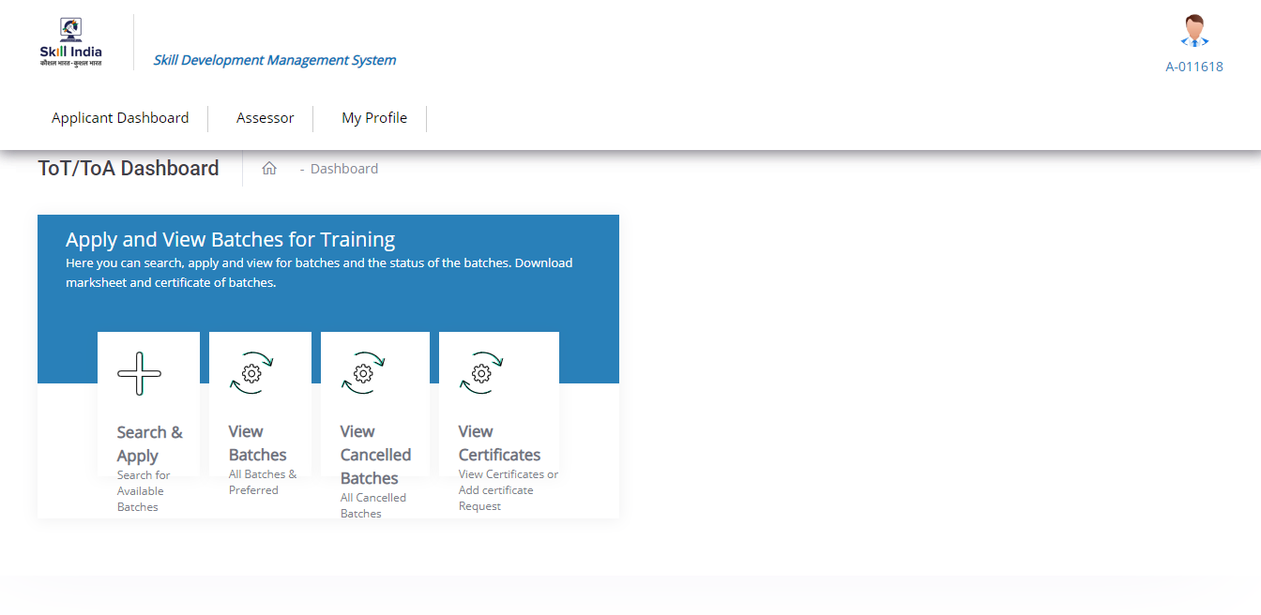
After Profile Completion Login -An Assessor

Slide 22
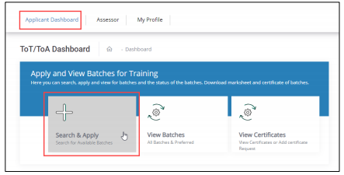
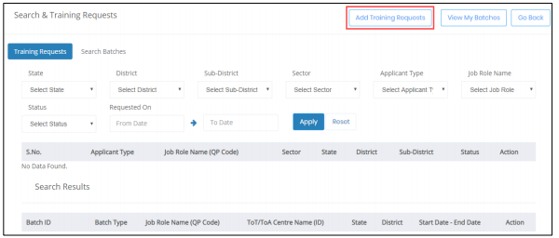
After Profile Completion Login -An Assessor (Add Training Request)

Slide 23
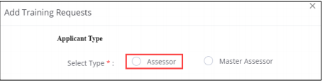
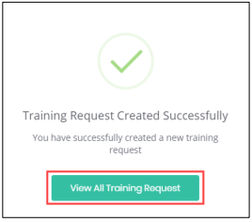
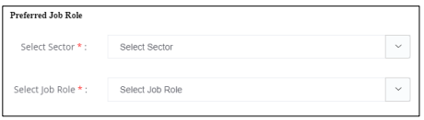
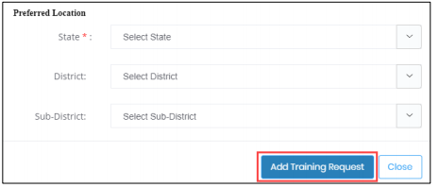
After Profile Completion Login -An Assessor (Add Training Request)

Slide 24
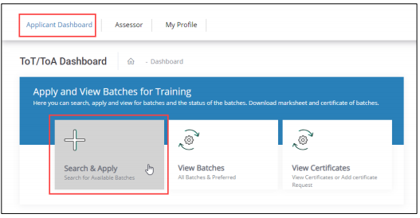
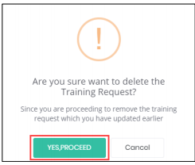
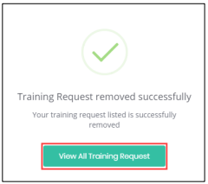
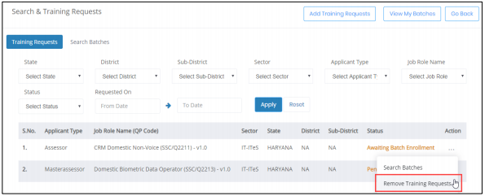
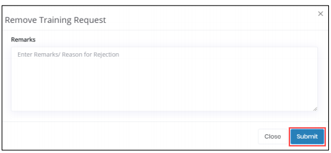
After Profile Completion Login -An Assessor (Remove Training Request)

Slide 25
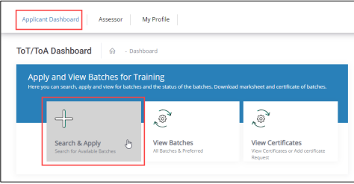
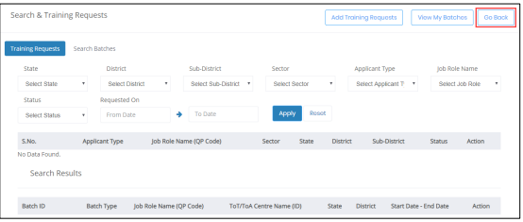
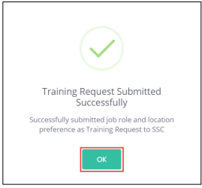
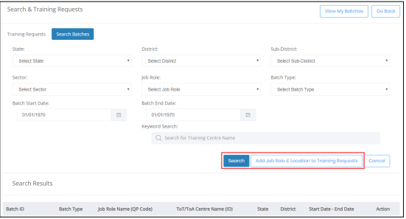
After Profile Completion Login -An Assessor

Slide 26
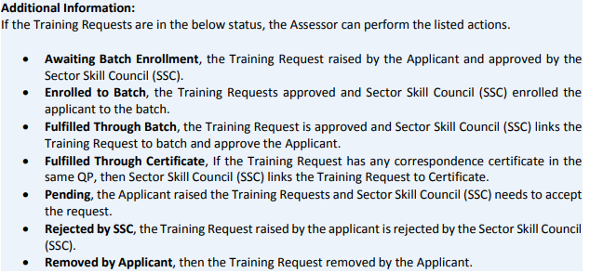
After Profile Completion Login -An Assessor

Slide 27
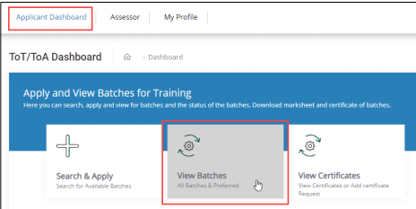
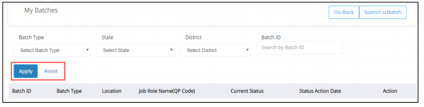
After Profile Completion Login -An Assessor

Slide 28
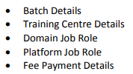
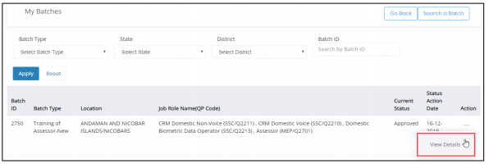
After Profile Completion Login -An Assessor

Slide 29
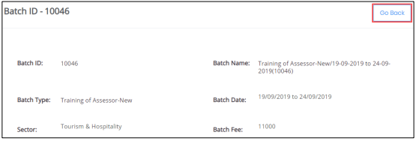
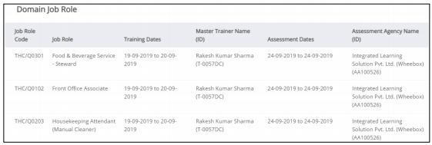
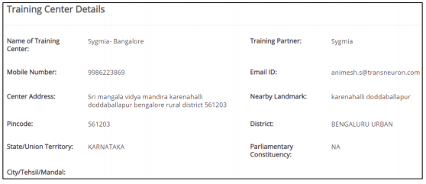
After Profile Completion Login -An Assessor

Slide 30
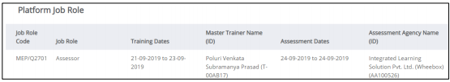
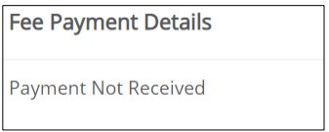
After Profile Completion Login -An Assessor

Slide 31

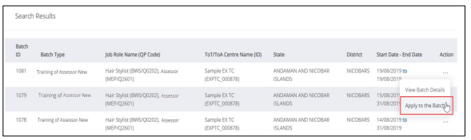
After Profile Completion Login -An Assessor

Slide 32
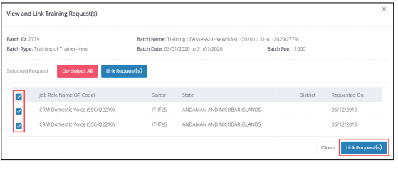
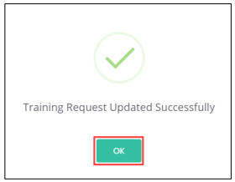
After Profile Completion Login -An Assessor

Slide 33

After Profile Completion-An Assessor

Slide 34

After Profile Completion-An Assessor

Slide 35

After Profile Completion-An Assessor

Slide 36

After Profile Completion-An Assessor

Slide 37

After Profile Completion-An Assessor

Slide 38


